Slide 1
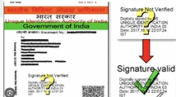
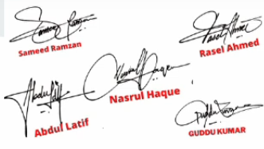
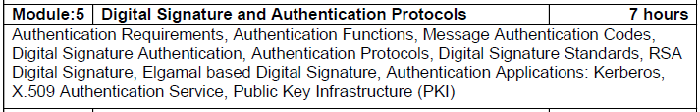
Digital Signature (DS)
Notes:
If the document is correct u get Digitally signed by so and so…

Slide 2
Digital Signature (DS)
It guarantees the source and verifies the integrity of the message.
DS is a cryptographic technique to validate the authenticity, software or documents.
Operations involved:
Generation of keys – generate public & private key pair.
Signing operation – generate the digital signature using private key of the sender.
Verification operation – verify the validity of the signature using public key of the sender.
Notes:
From whom this doc has come
There is no change in doc

Slide 3
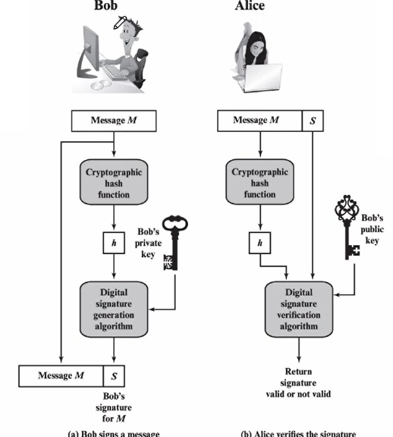
Digital Signature
Notes:
To join in college a income certificate
Bob- Village officer vao
Alice- student
Alice applied income certificate to join in college
In income certificate whatever the message is is the message
Aunthenticity- from whom the message is coming

Slide 4
Comparison of Hash, MAC and Digital Signature
 | Hash | MAC | Digital Signature
Integrity | Yes | Yes | Yes
Authentication | No | Yes | Yes
Non-repudiation | No | No | Yes
Kind of keys | None | Symmetric | Asymmetric

Slide 5
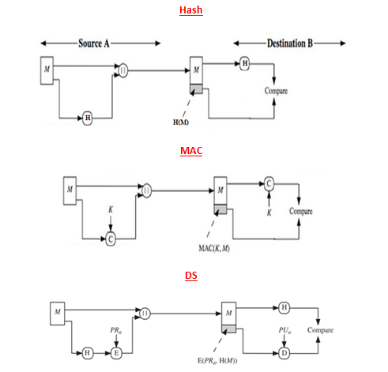

Slide 6
Digital Signature Algorithms
Elgamal based
RSA based
Digital signature standard (DSS)

Slide 7
Elgamal DSA

Slide 8
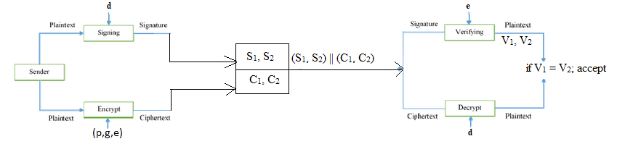
Elgamal DSA

Slide 9
Elgamal DSA
Sender A generates public and private keys:
Select a large prime as a ‘p’.
Select a random integer ‘d’ with 2 ≤ d ≤ p-1 and gcd(d,p) = 1.
Select ‘g’ (generator) to be a primitive root.
Compute e ≡ g^{d} mod p
Publishes (p,g,e) as his public key and ‘d’ as a private key.

Slide 10
Elgamal DSA
The sender A signs a message (M) using private key (d) to receiver B by computing:
The hash m = H(M), 0 ≤ m ≤ (p-1).
Chose random number k with 1 ≤ k ≤ (p-1) and gcd(k,p-1) = 1.
Compute temporary key S₁ = g^{k} mod p.
Compute k⁻¹ (inverse of k).
Compute the value: S₂ = k⁻¹ (m - dS₁) mod (p-1).
Signature is: (S₁, S₂).
The receiver B can verify the signature using public key of A ({p,g,e}) by computing:
V₁ = g^{m} mod p.
V₂ =(e)^{S1} (S₁)^{S2} mod p.
Signature is valid if V₁ = V₂

Slide 11
Example
Let us consider the prime number p = 19 & its primitive root g = 10.
Alice generates a key pair as follows:
Alice chooses d = 16.
Then e ≡ g^{d} mod p
e = 10¹⁶ mod 19 = 4.
Alice’s private key d= 16;
Alice’s pubic key is {p, g, e} = {19, 10, 4}.

Slide 12
Example
Suppose Alice wants to sign a message with hash value m = 14.
Alice chooses K = 5, which is relatively prime to p - 1 = 18.
S₁ = g^{K}mod p = 10⁵mod 19 = 3
K⁻¹ mod (p-1) = 5⁻¹ mod 18 = 11
S₂ = K⁻¹ (m - d S1) mod (p-1)
= 11(14 – (16*3)) mod 18
= -374 mod 18
S₂ = 4.
Signature is (S₁, S₂)

Slide 13
Example
Bob can verify the signature as follows;
V₁ = g^{m}mod p = 10¹⁴ mod 19 = 16
V₂ = (e)^{S1} (S₁)^{S2} mod p = (4)³ (3)⁴ mod 19 = 5184 mod 19 = 16
V₁ = V₂.Thus , the signature is valid.

Slide 14
Example
Let us consider the prime number p = 19 & its primitive root g = 10.
Alice generates a key pair as follows:
Alice chooses d = 16.
Then e ≡ g^{d} mod p = 10¹⁶ mod 19 = 4.
Alice’s private key d= 16;
Alice’s pubic key is {p, g, e} = {19, 10, 4}.
Suppose Alice wants to sign a message with hash value m = 14.
Alice chooses K = 5, which is relatively prime to p - 1 = 18.
S₁ = g^{K}mod p = 10⁵mod 19 = 3
K⁻¹ mod (p-1) = 5⁻¹ mod 18 = 11
S₂ = K⁻¹ (m - d S1) mod (p-1) = 11(14 – (16*3)) mod 18 = -374 mod 18 S₂ = 4.
Signature is (S₁, S₂)
Bob can verify the signature as follows;
V₁ = g^{m}mod p = 10¹⁴ mod 19 = 16
V₂ = (e)^{S1} (S₁)^{S2} mod p = (4)³ (3)⁴ mod 19 = 5184 mod 19 = 16
V₁ = V₂.Thus , the signature is valid.

Slide 15
RSA DS

Slide 16
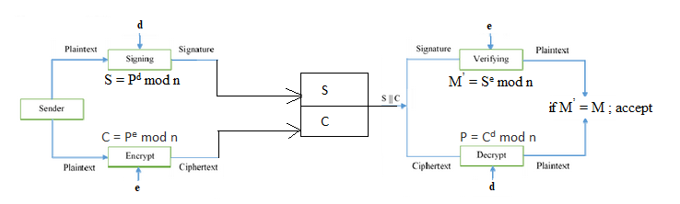
RSA DS

Slide 17
RSA DS
Sender A generates public and private keys:
Select two prime numbers ‘p’ and ‘q’ where p ≠ q.
Calculate n = p * q.
Calculate Ф(n) = (p-1) * (q-1).
Select ‘e’ such that, ‘e’ is relatively prime to Ф(n), i.e., gcd(e, Ф(n)) = 1 and 1 < e < Ф(n).
Calculate d = e ⁻¹ mod Ф(n) or e*d = 1 mod Ф(n).
PU (Public key) = {e, n},
PR (private key) = {d, n}.

Slide 18
RSA DS
The sender A signs a message (P) using private key (d) and send to receiver B by computing:
S = P^{d} mod n
Generate signature S.
The receiver B can verify the signature using public key (e) by computing:
M’ = S^{e} mod n
Signature is valid if M’ = M

Slide 19
Example
Let us consider p = 7, q = 13, P (plaintext) = 35
Key pair generation:
Compute n = pq = 7 * 13 = 91
Select e = 5
Compute Ф(n) = (p-1) * (q-1) = 6 * 12 = 72
Compute d:
e * d = 1 mod Ф(n)
5 * d = 1 mod 72
5 * 29 = 1 mod 72
d = 29
PU (Public key) = {e, n} = {5,91}
PR (private key) = {d, n} = {29, 91}

Slide 20
Example
Let us consider p = 7, q = 13, P (plaintext) = 35
Signature:
S = P^{d} mod n = 35²⁹ mod 91 = 42
S = 42
Verification:
M’ = S^{e} mod n
M’ = 42⁵ mod 91 = 35
M’ = M therefore signature is valid.

Slide 21
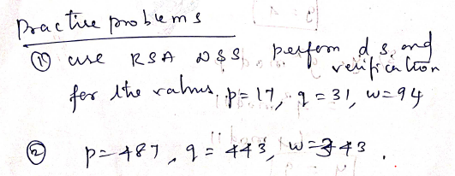
Example

Slide 22
Digital Signature Standard
In December 1994, on the proposal of the National Institute of Standards and Technology, the following Digital Signature Algorithm (DSA) was accepted as a standard.
It uses Secure Hash Algorithm(SHA).
Steps:
1. Key Generation
2. Signature Generation
3. Signature Verification

Slide 23
Digital Signature Standard
1. Key Generation:
Private Key:
The signer generates a unique, secret private key, which must be kept confidential.
Public Key:
The signer also generates a corresponding public key, which can be shared with others.

Slide 24
Digital Signature Standard
2. Signature Generation:
Hashing:
The content of the document to be signed is hashed using a cryptographic hash function(SHA), producing a unique "fingerprint" of the data.
Signing:
The hash value is then encrypted using the signer's private key, creating the digital signature.

Slide 25
Digital Signature Standard
3. Signature Verification:
Hashing:
The recipient independently hashes the received document using the same hash function.
Decryption:
The recipient decrypts the received digital signature using the signer's public key.

Slide 26
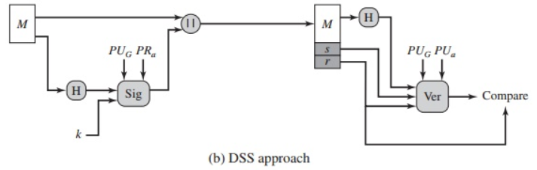
Digital Signature Standard
Overview of Digital Signature Standard
Notes:
Share the Public key{p,g,q}
Share public ke y
Private key is secret to users A
Sender A create digital Signature using {private key+message and message}
Receiver validates the digitl signature using public key
Then message is from Authenticated source and intergrity of the message is also maintained
---------------
Message –pass 100 rs,generate hash value
K- random integer+public key(p,q,g)+ private key-x
DS+ message Is added
Receiver:
Receives 100 rs,generate hash value
R and s is the DS
Fed to the verification module
Receiver also uses public key componenets and public key of user A

Slide 27
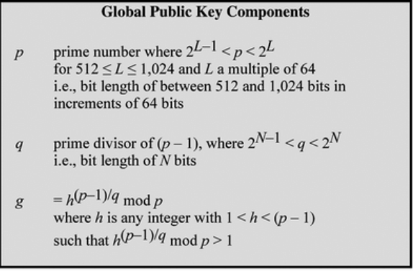
Generate Global Public Key Components{p,q,g}
Notes:
P – prime number
N= 160 bits

Slide 28
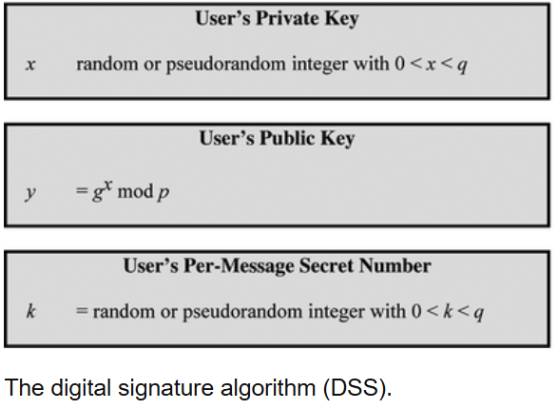
User’s public key and the private key
Notes:
X is the private key
G – public key component
Y - Public key of user
---------------
Generate Digital Signature{r,s}
Select random number k

Slide 29
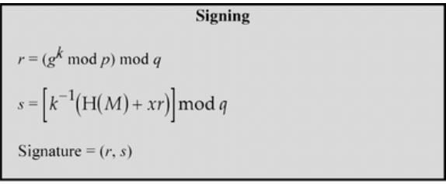
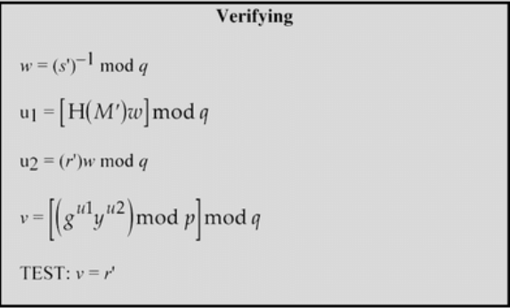
Signing and Verifying
Notes:
X is the private key
G – public key component
Y - Public key of user
---------------
Generate Digital Signature{r,s}
Select random number k
One signature is ready plaing text M +{r,s} is concentrated and sent to receiver
------------
Recver validates the message
---------m’,r’,s’ are the m,r, and s from the sender

Slide 30
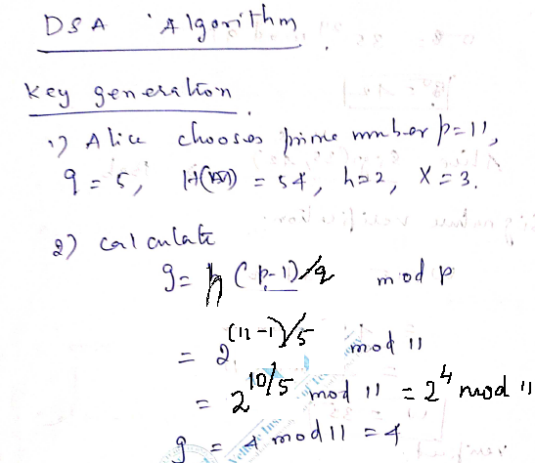
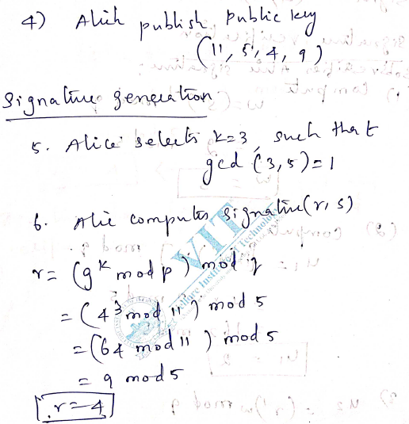
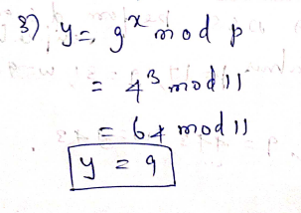
Exercise

Slide 31
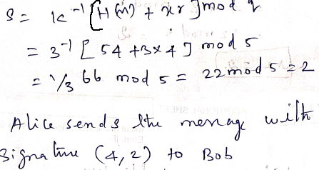
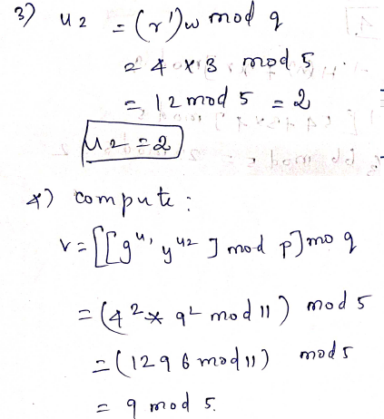
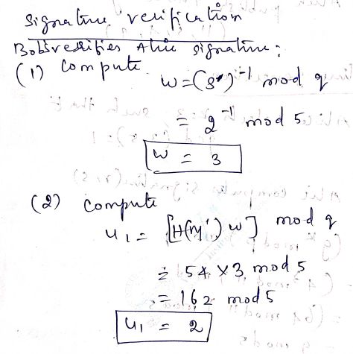
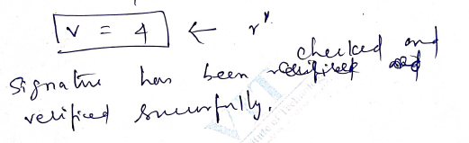
Exercise

Slide 32
From ElGamal to DSA
DSA is a modification of ElGamal digital signature scheme. It was proposed in August 1991 and adopted in December 1994.
Any proposal for digital signature standard has to go through a very careful scrutiny. Why?
Encryption of a message is usually done only once and therefore it usually suffices to use a cryptosystem that is secure at the time of the encryption.
On the other hand, a signed message could be a contract or a will and it can happen that it will be needed to verify a signature many years after the message is signed.
Since ElGamal signature is no more secure than discrete logarithm, it is necessary to use large p, with at least 512 bits.
However, with ElGamal this would lead to signatures with at least 1024bits what is too much for such applications as smart cards.
In DSA a 160 bit message is signed using 320-bit signature, but computation is done modulo with 512-1024 bits.
Observe that y and a are also q-roots of 1. Hence any exponents of r,y and a can be reduced module q without affecting the verification condition.
This allowed to change ElGamal verification condition: y ª a ^{b} = q ^{w}.

Slide 33
Exercise
1. Given parameters (p,q,g) =(283,47,60) and Alice private key = 24; Hash=H(M)=41.
Generate digital signature using DSS and verify the same.
2. Consider the ElGamal signature scheme with p = 467, α = 2 and X_{a} = 127. Perform detailed signing and verification procedures for the hash of the message h(M) = 100 and K = 213.

Slide 34
A MAN-IN-THE-MIDDLE-ATTACK
Consider the following protocol:
1. Alice sends Bob the pair (e_{B}(e_{B}(w)A), B) to B.
2. Bob uses d_{B} to get A and w, and acknowledges by sending the pair (e_{A}(e_{A}(w)B), A) to Alice.
(Here the function e and d are assumed to operate on numbers, names A,B,… are sequences of digits and e_{B}(w)A is a sequence of digitals obtained by concatenating e_{B}(w) and A.)
What can an active eavesdropper C do?
C can learn (e_{A}(e_{A}(w) B), A) and therefore e_{A}(w'), w ‘ = e_{A}(w)B.
C can now send to Alice the pair (e_{A}(e_{A}(w ') C), A).
Alice, thinking that this is the step 1 of the protocol, acknowledges by sending the pair (e_{C}(e_{C}(w ') A), C) to C.
C is now able to learn w ' and therefore also e_{A}(w).
C now sends to Alice the pair (e_{A}(e_{A}(w) C), A).
Alice acknowledges by sending the pair (e_{C}(e_{C}(w) A), C).
C is now able to learn w.

Slide 35
Security of digital signature
It is again very non-trivial to define security of digital signature.
Definition A chosen message attack is a process which on input of a verification key can obtain signature (corresponding to the given key) to message of its choice.
A chosen message attack is considered to be successful (in so called existential forgery) if it outputs a valid signature for a message for which it has not requested a signature during the attack.
A signature scheme is secure (or unforgeable) if every feasible chosen message attack succeeds with at most negligible probability.

